Slide 1

Salesforce RDF extension


Niklas Petersen
Omar Rana
Mintcho Tzatzarov
Alexander Melnyk

Slide 2
Outline
Architecture
Future Work


Discussion
Introduction





Requirements
Results
Demo

Slide 3

Introduction

Slide 4
Introduction
LUCID Project
Linked valUe ChaIn Data
Development of distributed networks of supply chain partners in order to exchange data about their work, their organization and their products.
Salesforce
Cloud computing company that provides a customer relationship management platform (SaaS and PaaS).

Slide 5


Perspective
RDF extension

Slide 6
Introduction
Goal
Create a prototype to read, write and transform data from salesforce.

Slide 7

Requirements

Slide 8
Requirements
Functional
Import
Export
Transformation
Nonfunctional
Interoperability
Usability
Performance
Notes:
Import and Export Objects from Salesforce
Transform RDF to Salesforce Objects and vice versa
Interoperability: provide as a REST web service
Usability: keep terms and workflows similar to salesforce
Performance: API limitations, response time of requests < 5 sec

Slide 9

Architecture

Slide 10
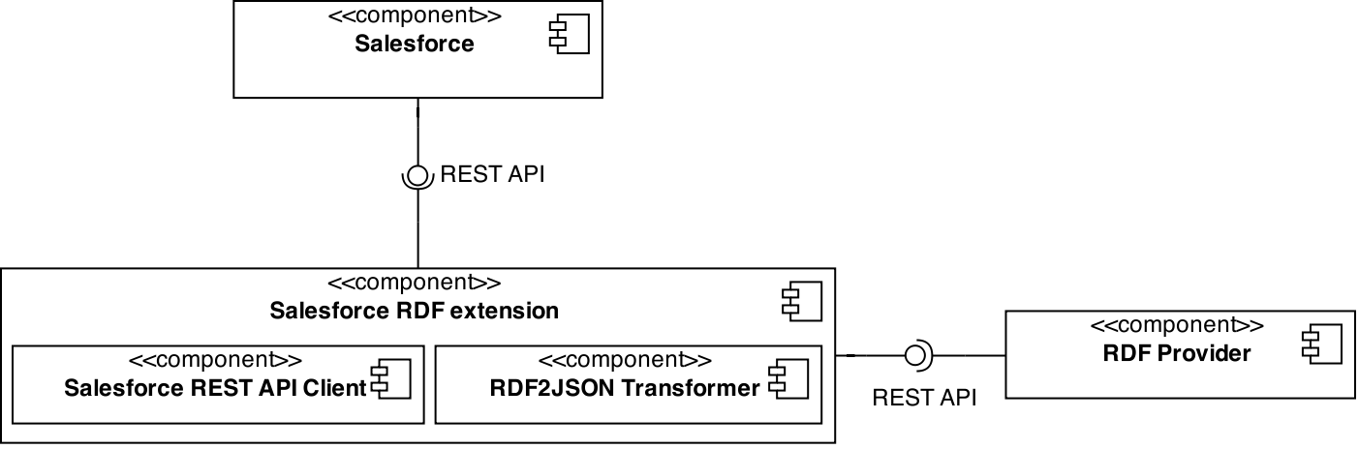
Architecture overview

Slide 11
Components
Salesforce REST API client
Core communication with API
Provide limited access
RDF2JSON transformer
Transformation of RDF, JSON
Based on provided input
Salesforce RDF extension
REST Web Service
Integration of components
RDF Provider / Test client
Input for the extension
Testing purposes

Slide 12

Results

Slide 13
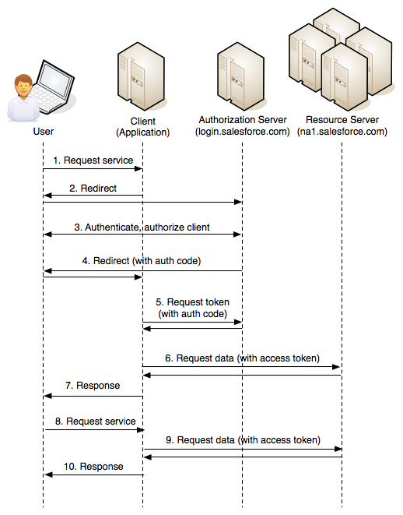
REST API Client
LoginService
Basic OAuth2 authentication mechanism. Must be configured in salesforce as external app.
ContactService
Access Contact objects of salesforce. Implemented as simple CRUD operations.
Salesforce OAuth2 authentication [1]

Slide 14
RDF Transformer
RDF → Contact
ContactService extracts foaf:person types and transforms them to contact objects. Use reflection to iterate over properties.
eccenca:stramp a foaf:Person ;
foaf:title "Dr." ;
foaf:givenName "Sebastian" ;
foaf:familyName "Tramp" ;
odette:position "Head of Development" ;
odette:telephoneNumber "+49 341 26508028" ;
odette:emailAddress "stramp@brox.de"
.
public class Contact {
private String title;
private String givenName;
private String familyName;
private String position;
private String telephoneNumber;
private String emailAdress;
}

Slide 15
RDF Transformer
Contact → RDF
Contact class implements a method to convert the instance to an RDF representation.
public String toRdf() {
Model model = ModelFactory.createDefaultModel();
Resource personResource = ResourceFactory.createResource("https://vocab.eccenca.com/mdm/"
+ this.getFamilyName());
model.add(personResource, RDF.type, FOAF.Person)
.add(personResource, FOAF.givenname, this.getGivenName())
.add(personResource, FOAF.family_name, this.getFamilyName());
OutputStream outputStream = new ByteArrayOutputStream();
model.write(outputStream);
return outputStream.toString();
}

Slide 16

Future Work

Slide 17
Future work
Support more sales objects
The focus of this work was only on Contact objects. Salesforce has more objects that needs to be integrated.
Generalize RDF transformation
The implemented RDF transformer know only one vocabulary.
Provide more feedback
Limited exception handling. More feedback would make the extension robust and usable.

Slide 18

Demo

Slide 19
References
[1] Salesforce Oauth 2.0: https://developer.salesforce.com/page/Digging_Deeper_into_OAuth_2.0_on_Force.com

